Slide 1
ISG Sprint Demo Event: OGC and Khronos Group |
Dr. Scott Serich, Director, OGC>
September 25, 2020

Slide 2
Demo Agenda
… can be found in the GitHub repository at https://github.com/opengeospatial/OGC-ISG-Sprint-Sep-2020/wiki/ISG-Sprint-Demo-Event-Agenda .

Slide 3
Welcoming Remarks
Welcome.
Purpose of today’s event.
Team Members
Sponsor reps.
USSOCOM, AGC.
Participants.
CAE, Cesium, Cognitics, Ecere, Helyx, Hexagon, InfoDao, SimBlocks, Steinbeis.
OGC and Khronos Group.
Invited Guests.
A quick note of thanks.

Slide 4
Invited Guests
Invited Guests.
Sponsor Team.
OGC and Khronos Group.
Participants.

Slide 5
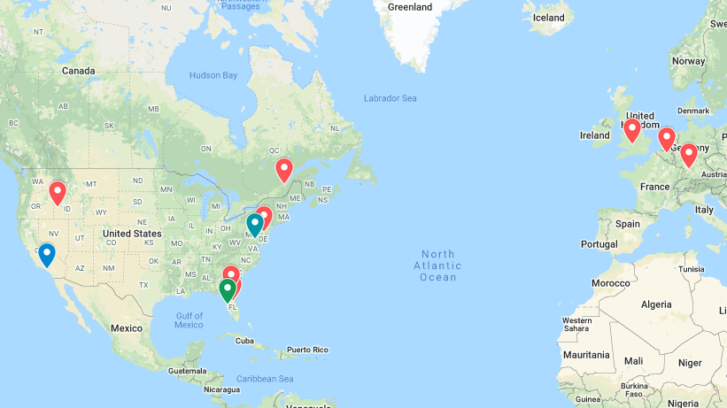
Where in the World

Slide 6
OGC 3D Data Container and Tiles API Pilot
The Pilot created a draft specification for access and query of 3D geospatial data, with a corresponding container format for streamed data delivery compatible with glTF.
API– GeoVolumes Spec
https://portal.ogc.org/files/?artifact_id=94029 .
Executive Summary
https://portal.ogc.org/files/?artifact_id=94030 .
Pilot Experiences
https://portal.ogc.org/files/?artifact_id=94028 .
The Sprint built on Pilot momentum to test additional capabilities based on San Diego CDB source data.

Slide 7
Participant Presentations
CAE, Cesium, Cognitics.
Pause for Q&A.
Helyx, Ecere, InfoDao.
Pause for Q&A.
Hexagon, Steinbeis, SimBlocks.
Additional Q&A.

Slide 8
Q&A
Any additional questions or comments?
.

Slide 9
Wrap-Up and Next Steps
Upload (reworked) videos to OGC YouTube Channel
https://www.youtube.com/user/ogcvideo/playlists .
Additional TIE Testing next week.
Participant Sprint Report inputs due October 5.
AOB?

Slide 10
Thank you.
Thank you.

